Slide 1
Microwave Devices E511
Lecture 3
Amr Al.Awamry

Slide 2
Agenda
GENERAL SOLUTIONS FOR TEM, TE, AND TM
RECTANGULAR WAVEGUIDE
CIRCULAR WAVEGUIDE

Slide 3
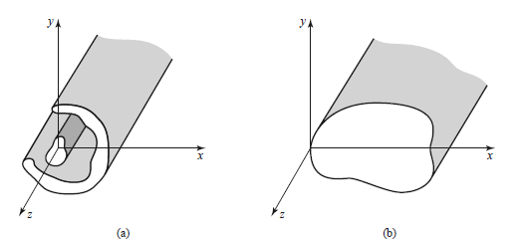
GENERAL SOLUTIONS FOR TEM, TE, AND TM

Slide 4
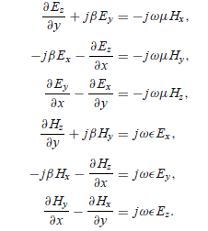
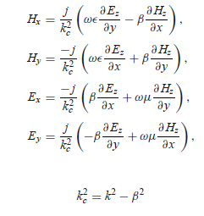
GENERAL SOLUTIONS FOR TEM, TE, AND TM ..Cont.

Slide 5
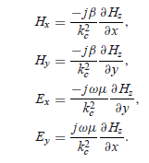
GENERAL SOLUTIONS FOR TEM, TE, AND TM ..Cont.
In TEM waves
In TE waves
Attenuation is self reading

Slide 6
GENERAL SOLUTIONS FOR TEM, TE, AND TM ..Cont.
TM waves

Slide 7
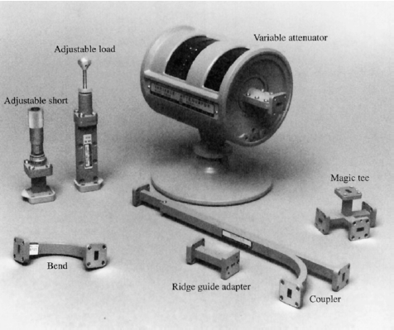
RECTANGULAR WAVEGUIDE

Slide 8
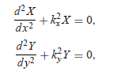
RECTANGULAR WAVEGUIDE

Slide 9
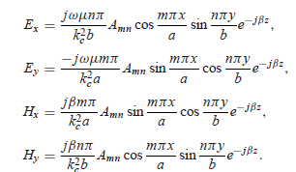
RECTANGULAR WAVEGUIDE
Boundary conditions

Slide 10
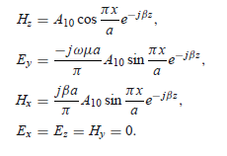
RECTANGULAR WAVEGUIDE
Dominant mode TE₁₀

Slide 11
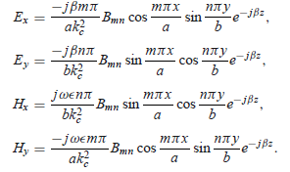
RECTANGULAR WAVEGUIDE ……TM mode

Slide 12
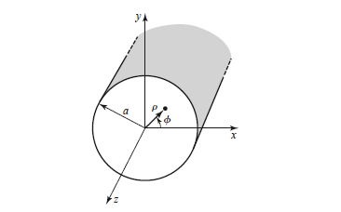
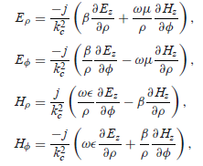
CIRCULAR WAVEGUIDE

Slide 13
CIRCULAR WAVEGUIDE …. Cont. TE mode

Slide 14
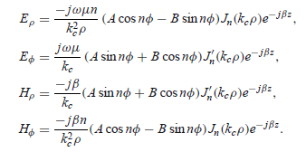
CIRCULAR WAVEGUIDE …. Cont. TE mode

Slide 15
CIRCULAR WAVEGUIDE …. Cont. TM mode

Slide 16
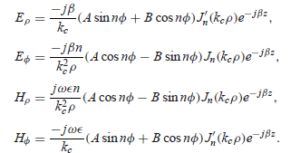
CIRCULAR WAVEGUIDE …. Cont. TM mode

